Slide 1
Data Science Project: Fish4U Predictions
By: Aaron Hogancamp
01-OCT-16

Slide 2

Project Table of Contents
Overview
Goals
Limitations
Data Science
Data
Journey
Conclusion
Conclusions
Final Suggestion

Slide 3
Overview
Disclaimer:
As a research and development data scientist with my current company, all of the projects I have completed are considered intellectual property with patent pending. I cannot ethically divulge the successes and failures for my recent major projects.
Given that, I have successfully completed an old data scientist competition project on fictitious data held by Blue Apron in order to present here. The following is the Fish4U challenge.
Notes:
Add a sentence to say that patents were applied for. Remove first and third person.

Slide 4
Overview
Problem Definition
A New York City start-up company, Fish4U, is a subscription service for ordering fish that can be turned on and off per week per customer. Being a fish market, the product (fish) spoils week to week, and it is import to save costs by accurately ordering the upcoming week’s orders.

Slide 5
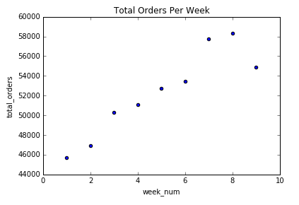
Overview
Problem Visualization
Accurately predict the total orders for these weeks and beyond.

Slide 6
Overview
Motivation
Fish4U has captured historical ordering data on some of its customers for the first 10 weeks of each customer’s subscription service.
Intuitively, the Fish4U CEO thinks that the customer’s subscription longevity plays a role in if they order or not each week.
Discover a method that will accurately predict each week’s overall order count based on both the historical data and each customer’s subscription longevity if possible.

Slide 7
Goals and Scope
Find any hidden relationships in the data if they exist.
Prove or disprove that subscription longevity impacts ordering habits. (i.e. a long-time customer will order more consistently)
Create a prediction that accurately describes the known week orders.
Generate a cost function to describe the accuracy of the predictions.

Slide 8
Limitations
The history only captures data for the first 10 weeks of a subset of customers.
One of the table’s descriptions have a column called “User’s Total Orders to Date”. This column does not really exist in the dataset anywhere.
This column, in combination with the known user subscription age in weeks, would be extremely useful in developing more accurate probabilities of ordering.
Without this column, probabilities of ordering were extrapolated from the first 10 weeks leaving model weakness as over-fitting.

Slide 9
Data Science: Data
Dataset Descriptions
User Fulfillment History
Describes when users have received fish relative to their own start week (e.g. all users are age 1 on week index 1).
This data is a selection of users that have at least 10 weeks of history with the company.
Format : user ID, week index, received fish (0 no/ 1 yes)
Weekly User Population
Description : Distribution of ages for all existing users for a given week
Format : Week ID, User ID, User’s Age
Weekly Orders
Description : How many orders ended up getting fulfilled for a given week
Format : Week ID, Total Orders for that week

Slide 10
Data Science: Data
Dataset Fidelity
User Fulfillment History
3 columns: 1 continuous numerical, 1 ordinal numerical, 1 categorical text
1,629,730 observations
No missing or incomplete observations
Weekly User Population
3 columns: 1 continuous numerical, 2 categorical text
1,356,423 observations
No missing or incomplete observations
Weekly Orders
2 columns: 1 continuous numerical, 1 categorical text
9 observations
No missing or incomplete observations

Slide 11
Data Science: Journey
Cost Function
A cost function is required to compare different prediction models to each other. For this project, we will define the cost function to be the sum of the absolute value of the differences between predictions and the actual total orders. For example, see below:
Week Number | Actuals | Predicted | Absolute Differences
1 | 100 | 105 | 5
2 | 100 | 98 | 2
3 | 100 | 101 | 1
4 | 100 | 94 | 6
 |  | Cost | 14

Slide 12
Data Science: Data
Dataset Facts
History is not available for all of the current customers, and history is available for customers that no longer subscribe.

Slide 13
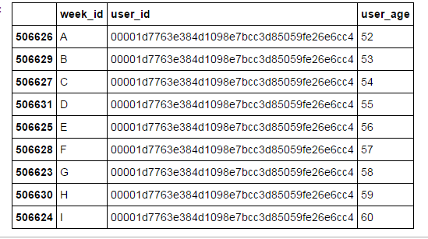
Data Science: Data
Dataset Facts
Validation that the prediction weeks (A-I) are consecutive in time. My time spent in Software Quality Assurance imbedded in me the famous Ronald Reagan quote “Trust But Verify”.

Slide 14
Data Science: Data
Dataset Facts
Customer counts are increasing each week, but total orders do not, specifically in week 9.

Slide 15
Data Science: Data
Dataset Facts
Weekly Rate Data
Week Number | New Customers | Dropped Customers | Weekly Customer Count | Total Orders
1 | - | 1,473.00 | 121,975.00 | 45,743.00
2 | 8,724.00 | 2,383.00 | 129,204.00 | 46,911.00
3 | 9,101.00 | 2,420.00 | 135,894.00 | 50,322.00
4 | 9,265.00 | 2,552.00 | 142,722.00 | 51,109.00
5 | 9,221.00 | 2,004.00 | 149,392.00 | 52,755.00
6 | 9,101.00 | 2,791.00 | 156,505.00 | 53,490.00
7 | 8,653.00 | 4,726.00 | 162,374.00 | 57,781.00
8 | 9,163.00 | - | 166,827.00 | 58,330.00
9 | 9,026.00 | - | 171,237.00 | 54,857.00

Slide 16
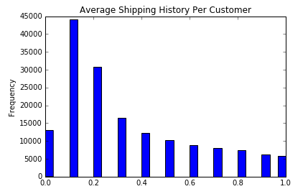
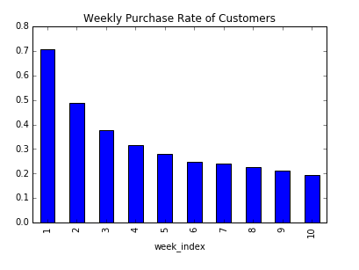
Data Science: Data
Historical Data
The majority of the historical customers only ship up to 20% of the time. Likewise, the subscription rate of a new customer drops significantly each week for the first several weeks after starting a subscription service.

Slide 17
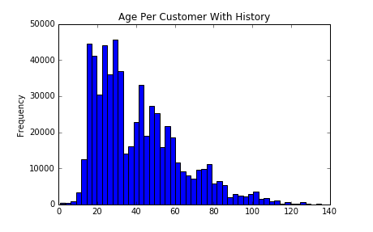
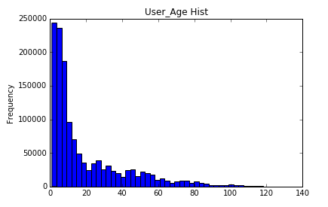
Data Science: Data
Historical Data
Does the overlap historical data represent the full population well in terms of age? It represents most of the range of ages well but not the distribution of ages.

Slide 18
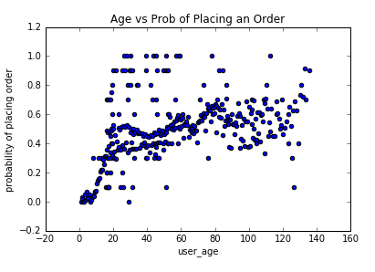
Data Science: Data
Historical Data
There seems to be some visual evidence that the CEO was correct in that longevity plays a role in the likelihood that the customer will place an order. However, there’s a lot of variance in outliers.

Slide 19
Data Science: Data
Let’s use what we’ve learned and try to predict the weekly values. To recap:
The historical data is fairly representative of the current weekly population in terms of age.
There might be a way to use a customer’s age in predicting the probability of the customer to place an order.
There is a very obvious downward trend in how many place an order as time goes by in general.

Slide 20
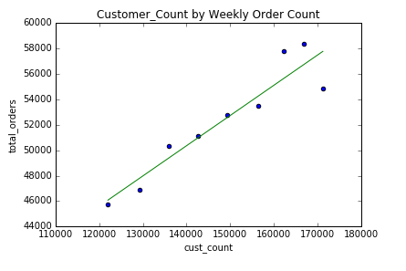
Data Science: Journey
Naïve Approach
What if we ignored everything else and just created a best fit line against the total orders per week by pure customer count per week? At the very least, this method is a good base comparison.
Cost Function Value
9,851
* This cost function value is read as either overestimating or underestimating 9,851 orders.
Notes:
Keep out of KISS

Slide 21
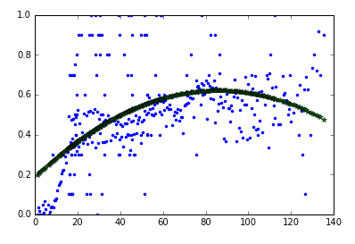
Data Science: Journey
Using age to predict values
Assumes a customer is purchasing orders at the same rate as the first 10 weeks of their subscription service; this is extrapolated to all current customers based on current age.
Quadratic Fit into
Age by Probability of Placing an Order
Function | Cost Function
Linear | 77,333
Quadratic | 21,970
Cubic | 97,913
Order 4 | 122,641
Order 5 | 151,293
Logarithmic | 66,784
Exponential | 208,238

Slide 22
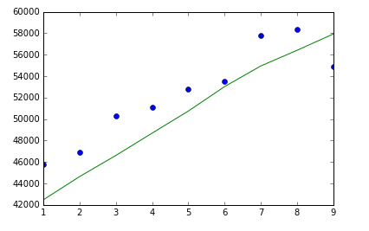
Data Science: Journey
Using age to predict values
Attempts were made to fit polynomials up to order 5 as well as logarithmic and exponential curves. Quadratic fit best in terms of the cost function value. The resulting set of weekly predictions based on quadratic results is below.
Quadratic Predictions against the Actual Total Orders
Cost Function Value
21,970
* This cost function value is read as either overestimating or underestimating 21,970 orders.

Slide 23
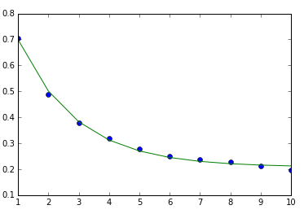
Data Science: Journey
Using time to predict values
Extrapolates the probability of purchasing an order from the first 10 weeks to later ages. This clearly disproves the assumption that customers purchase at the same rate over time.
Exponential Decay Fit onto Weekly Purchase Rate of Customers to Extrapolate to later ages.
Notes:
.6 likelihood of customers ordering new data, which means 9K new customers a week = 18K customers in the first 2 weeks, which means ~10K (20%) of the orders each week are from new customers.

Slide 24
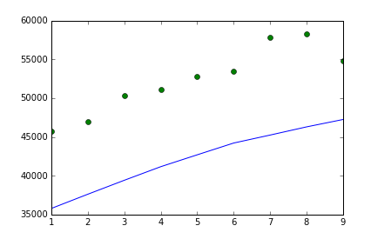
Data Science: Journey
Using time to predict values
The resulting set of weekly predictions based on exponential decay extrapolation results is below.
Exponential Decay Fit onto Weekly Purchase Rate of Customers to Extrapolate to later ages.
Cost Function Value
91,643
* This cost function value is read as either overestimating or underestimating 91,643 orders.

Slide 25
Data Science: Conclusion
The lowest cost function was the initial naïve approach. While it does not take into consideration customer age, just using customer count seems to explain the variance in the data the most.
Cost Function Value
9,851
* This cost function value is read as either overestimating or underestimating 9,851 orders.

Slide 26
Data Science: Conclusion
Hidden relationships:
Customers in the first two weeks are extremely likely to place an order compared to longer customers (estimated ~60% likelihood). We also know that we have around ~18,000 customers that fit into this category each week.
Week Number | New Customers
1 | -
2 | 8,724.00
3 | 9,101.00
4 | 9,265.00
5 | 9,221.00
6 | 9,101.00
7 | 8,653.00
8 | 9,163.00
9 | 9,026.00

Slide 27
Data Science: Conclusion
Hidden relationships:
Using these observations in combination with the total orders per week, we can estimate that ~18,000 “new customers” * 0.6 probability new customers place an order = 10,800 orders are from new customers each week. That’s around 16%-20% of the weekly order counts.

Slide 28
Data Science: Conclusion
Other ideas to attempt if time allowed:
Machine Learning
Use machine learning algorithms to discover the interaction between the historical data available and a person’s current age to predict the probability of placing an order.
Bayesian statistics
Try to categorize the data using a Binomial Beta distribution by finding the probability of placing an order given the age distribution.

Slide 29
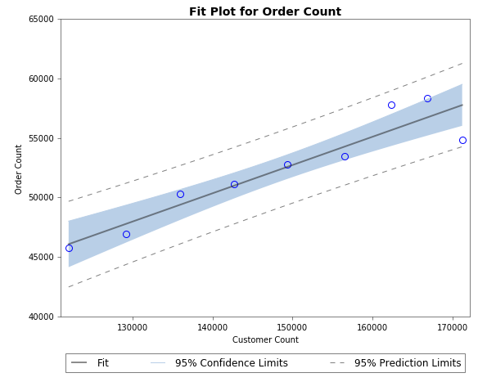
Data Science: Conclusion
Final Suggestions to Fish4U CEO
Use the upper 95% prediction limits to minimize waste and also confidently order as much as is needed without worrying about running out of fish and losing customer satisfaction.
The CEO should also focus on customer retention in case the new customer rate drops.

